Slide 1

Project Title –SEASONAL AGRICULTURE PERFORMANCE ANALYSIS
Student name:SUBIKSHA
college name:Karpagam Academy of Higher Eduactaion
AICTE STU ID : STU681a3467b33691746547815

Slide 2

PROBLEM STATEMENT
Agricultural performance varies significantly across different seasons due to changes in rainfall, temperature, soil conditions, water availability, crop selection, and farming practices.However, it can be difficult to understand which factors have the greatest impact on crop yield and farm profitability when looking at agricultural data across different regions and seasons.
This project analyzes agricultural data to:
Identify seasonal variations in crop yield and profitability.
Understand relationships between environmental and farming factors.
Compare crop, season, and regional performance.
Identify important patterns, trends, and unusual observations.
Generate data-driven insights and recommendations for improving agricultural performance.

Slide 3
Project Description
Seasonal Agriculture Performance Analysis is a data analysis project that examines agricultural performance across different seasons, crops, and regions.
The project uses agricultural data containing information about weather conditions, soil characteristics, farming practices, crop yield, production, costs, revenue, profit, and water usage.
The analysis involves:
Cleaning and preparing the agricultural dataset.
Exploring seasonal, crop, and regional performance.
Analyzing relationships between environmental factors and crop yield.
Comparing agricultural profitability across seasons, crops, and states.
Identifying important patterns, trends, and unusual observations.
Using data-driven insights to provide recommendations for improving agricultural performance.
Applying a Random Forest regression model to explore yield prediction.

Slide 4

WHO ARE THE END USERS?
Farmers
Use seasonal yield, rainfall, soil, water, and profitability insights to make better crop and farming decisions.
Agricultural Departments & Government Agencies
Use regional and seasonal performance patterns to support agricultural planning, resource allocation, and policy decisions.
Agribusiness & Agricultural Planners
Use crop, cost, revenue, and profit analysis to identify better-performing crops, seasons, and farming opportunities.
Agricultural Researchers & Analysts
Use the analyzed data and identified relationships to study agricultural trends and support further research.

Slide 5

Technology Used
Python -Core programming language used for data analysis and machine learning.
Pandas -Used for data loading, cleaning, transformation, grouping, and analysis.
NumPy-Used for numerical operations and data processing.
Matplotlib-Used to create charts and visualizations.
Seaborn-Used for statistical visualizations such as heatmaps and comparison plots.
Scikit-learn-Used for preprocessing, train-test splitting, and the Random Forest regression model.
Google Colab / Jupyter Notebook-Environment used to develop and execute the project.

Slide 6
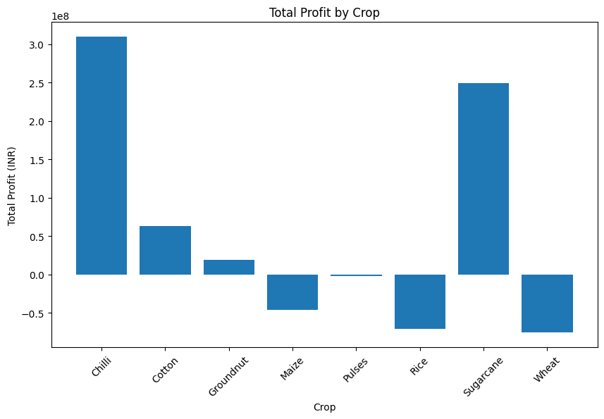
RESULTS
Kharif: Highest total profit
Rabi: Moderate total profit
Zaid: Lowest total profit / overall loss

Slide 7
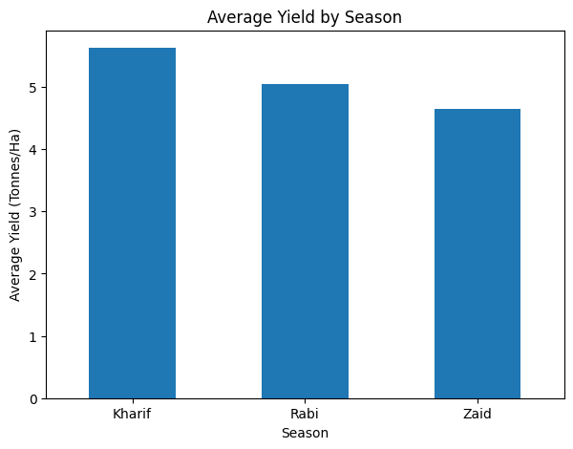
RESULTS
Kharif: 5.63 tonnes/ha
Rabi: 5.04 tonnes/ha
Zaid: 4.64 tonnes/ha
Kharif Season Performs BestKharif recorded the highest average yield of 5.63 tonnes/ha and the highest average profit of ₹178,914.65.🌧️
Rainfall & Soil Moisture MatterKharif had the highest average rainfall (849.20 mm) and soil moisture (31.15%), supporting better crop performance.
Rabi Shows Moderate PerformanceRabi achieved an average yield of 5.04 tonnes/ha with an average profit of ₹87,689.47.
Zaid Shows Weak PerformanceZaid had the lowest average yield (4.64 tonnes/ha) and recorded an average loss of ₹24,804.82.
High Water Usage in ZaidZaid used the highest average water (6,419.89 m³) despite having the lowest yield.
Zaid Has Higher Temperature StressZaid recorded the highest average temperature of 31.04°C, along with lower rainfall and soil moisture.🐛 Higher Disease/Pest Risk in KharifKharif recorded an average disease/pest risk of 54.47%.
Seasonal Conditions Influence ProfitabilityDifferences in environmental conditions, farming practices, yield and costs contribute to significant differences in seasonal profitability.

Slide 8
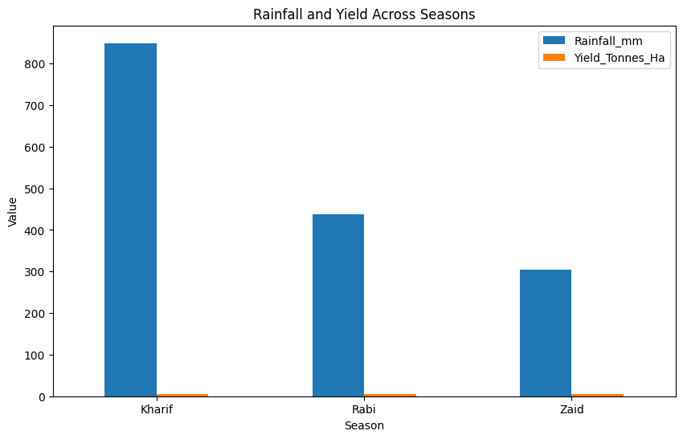
RESULTS

Slide 9
Future scope
Real-Time Data Integration
Incorporate live weather, rainfall, soil, and market-price data for real-time analysis.
Advanced Crop Yield Prediction
Compare Random Forest with other machine learning and deep learning models to improve prediction accuracy.
Regional-Level Analysis
Expand the analysis to provide more detailed insights for specific states, districts, and farming regions.
Smart Irrigation Recommendations
Use rainfall, soil moisture, and water usage data to suggest efficient irrigation strategies.
Crop Selection Support
Develop a recommendation system to identify suitable crops based on seasonal and environmental conditions.
Interactive Dashboard
Build a user-friendly dashboard where farmers and agricultural planners can explore seasonal performance and predictions.

Slide 10
GitHub Link
https://github.com/subi237/seasonal-agriculture-performance-analysis

Slide 11

VOIS Course completion certificate -
Course name- Data Visualization

Slide 12
Thank you
.
.

